Slide 1
Shri B.V.V.Sangha’s
BASAVESHWAR ENGINEERING COLLEGE (AUTONOMOUS)
BAGALKOT-587 102.
[TEQIP Lead Institute, Govt. Aided Institution, AICTE Recognized, Affiliated to VTU Belgaum]
DEPARTMENT OF COMPUTER SCIENCE
AND ENGINEERING (CSE)
Visveswaraiah Technological University, Belgaum

Slide 2
A Mini project on:
“SURVIVE ON KNOWLEDGE”
Under the guidance of :-Prof.Smitha K
Submitted to :- Prof.Savita Hanji
Submitted by:-
Vivek Halakatti 2BA18CS081

Slide 3
INDEX
Chapter | Contents
1 | Introduction
2 | Overview of OpenGL
3 | Problem definition and description
4 | Implementation
5 | Snapshots
6 | Conclusion
7 | Bibliography

Slide 4
INTRODUCTION
Graphics provides one of the natural means of communicating with a computer.
Graphics has also become a key technology for communicating ideas, data and trends in most areas of commerce, science, engineering and education.
So graphics refers to pictures, sketch of building, flowcharts, control flow diagrams, bar charts, and pie charts.
Computer graphics is the creation, manipulation and storage of models and images of picture objects by the aid of computers.
The term computer graphics has been used in a broad sense to describe almost everything on computers that is not text or sound

Slide 5
OVERVIEW OF OPENGL
Computer graphics started with the display of data on hardcopy plotters and cathode ray tube (CRT) screens soon after the introduction of computers.
Computer graphics today largely interactive, the user controls the contents, structure, and appearance of objects and of displayed images by using input devices, such as keyboard, mouse, or touch-sensitive panel on the screen.
Graphics based user interfaces allow millions of new users to control simple, low-cost application programs, such as spreadsheets, word processors, and drawing programs.
OpenGL (Open Graphics Library) is a standard specification defining a cross-language, cross-platform API for writing applications that produce 2D and 3D computer graphics.
The interface consists of over 250 different function calls which can be used to draw complex three-dimensional scenes from simple primitives. OpenGL was developed by Silicon Graphics Inc. (SGI) in 1992 and is widely used in CAD, virtual reality, scientific visualization, information visualization, and flight simulation.

Slide 6
PROBLEM DEFINITION
In the Helicopter Game in C/C++, certain keys have been fixed to play the game. The Left Mouse button, lifts the helicopter up or helps to gain the height where as the Right Mouse button is for landing the helicopter.
If no key is pressed, the helicopter loses its height.
In the game, you have to keep the helicopter flying without any collision with the vertical walls or the obstacles in the game.
If the helicopter collides with any obstacles, the game is stopped and you will get back to main menu.
The more you are able to keep the helicopter flying without collision, the more score you will gain.

Slide 7
SYSTEM REQUIREMENTS
Software Requirements
Operating System:-Ubuntu 20.04 .
Language:-C/C++
Hardware Requirements
Processor:-Pentium PC
RAM:-128 MB
Compiler:-Codeblocks 20.03.
OpenGL:-Basic library Files And glut files
Hard Disk:-20GB(approx.)
Monitor:-VGA Color Monitor

Slide 8
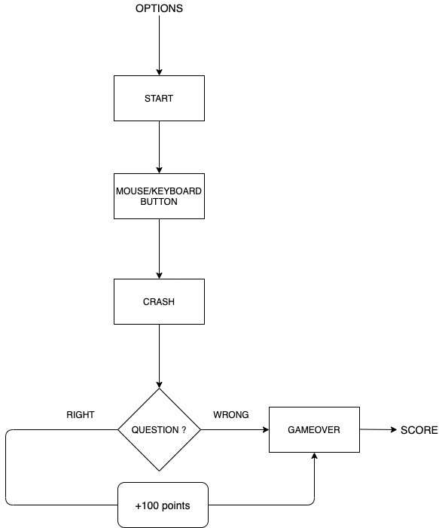
IMPLEMENTATION

Slide 9
WORKING
The objective of the game is to fly a helicopter in space with restricted upward and downward motion using either mouse or keyboard, meanwhile walls will move towards player’s copter and player have to avoid a collision between them.
The game will enter into next level as soon as player crosses next certain fixed unit distance and speed of wall will increase by a certain fixed amount each time player enter next level.
The basic feature of the 2D game were analyzed to be: -

Slide 10
1. A welcome screen which contains following buttons: -
i) PROFILE: - player can make his/her own profile to save his level and score.
ii) ABOUT: - Display about the game.
iii) CONFIGURATION: Player can either choose the key for up and down or can also use mouse button for the action of copter and can change the color of copter.
iv) START: - clicking on which game will start with the customized configuration.
2. Calculating distance travelled by copter and displaying and updating it continuously as score of player while game is on.
3.After a crash, there will be a question popping up, depending on your answer being right or wrong, your score will either be incremented by 100 or remains the same respectively.

Slide 11
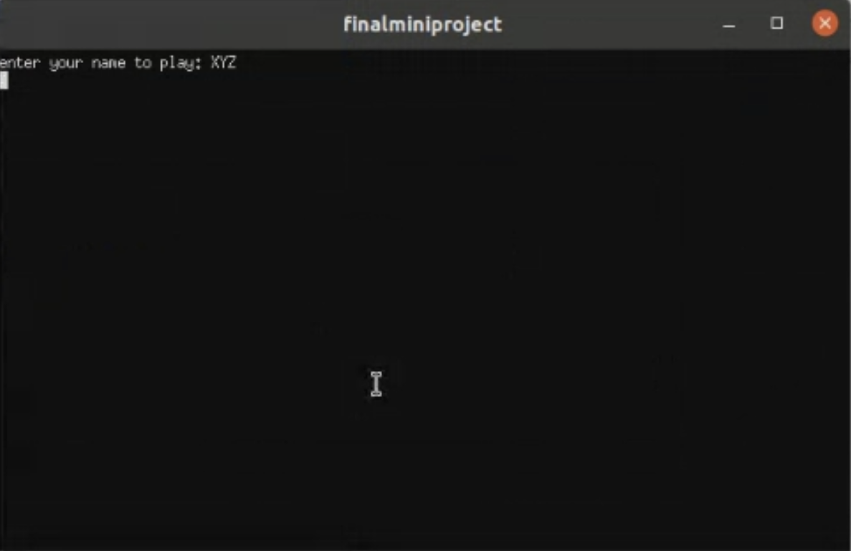

Slide 12
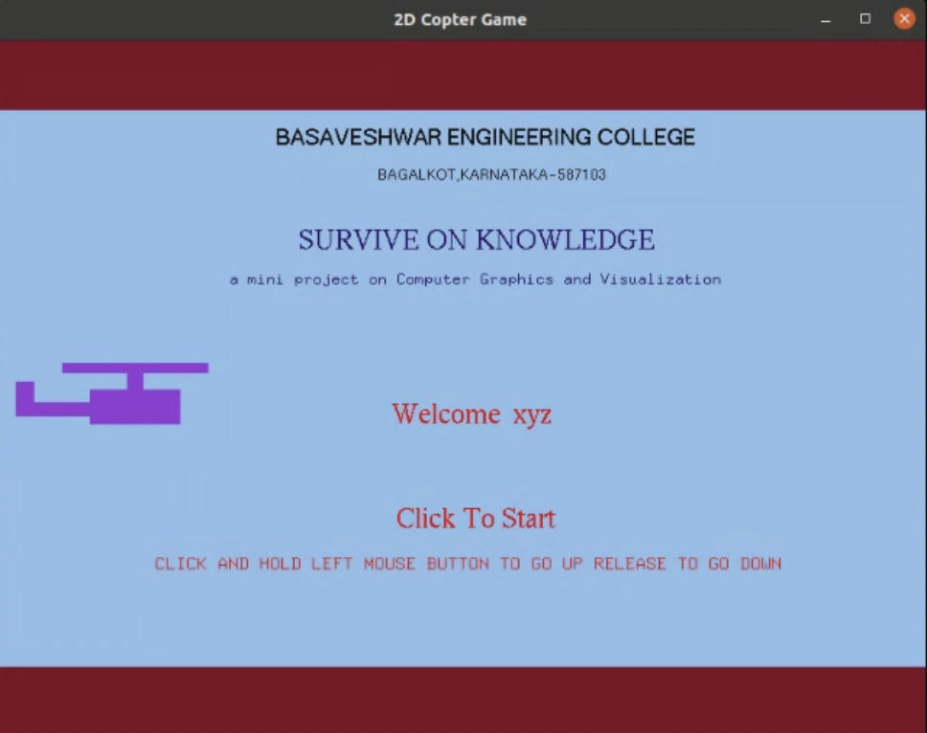

Slide 13
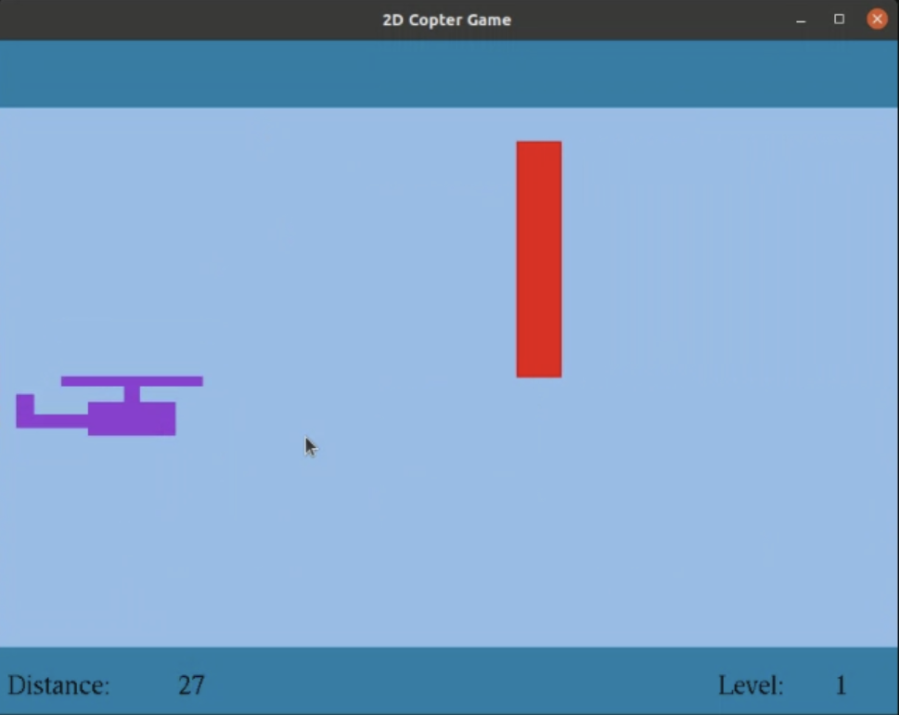

Slide 14
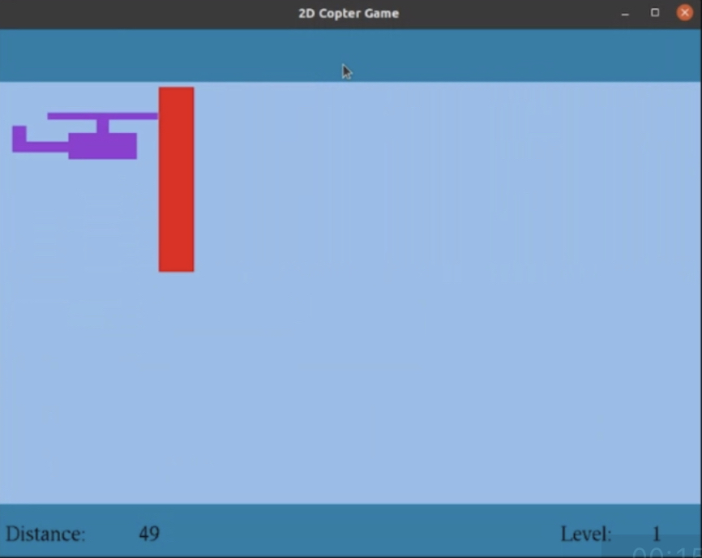

Slide 15
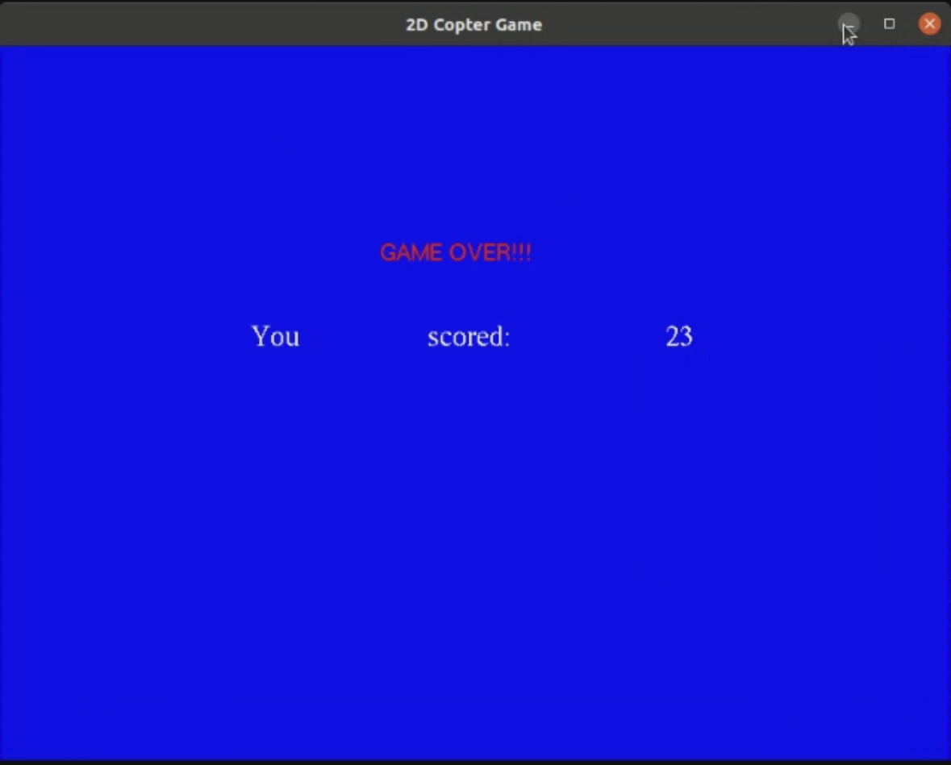

Slide 16
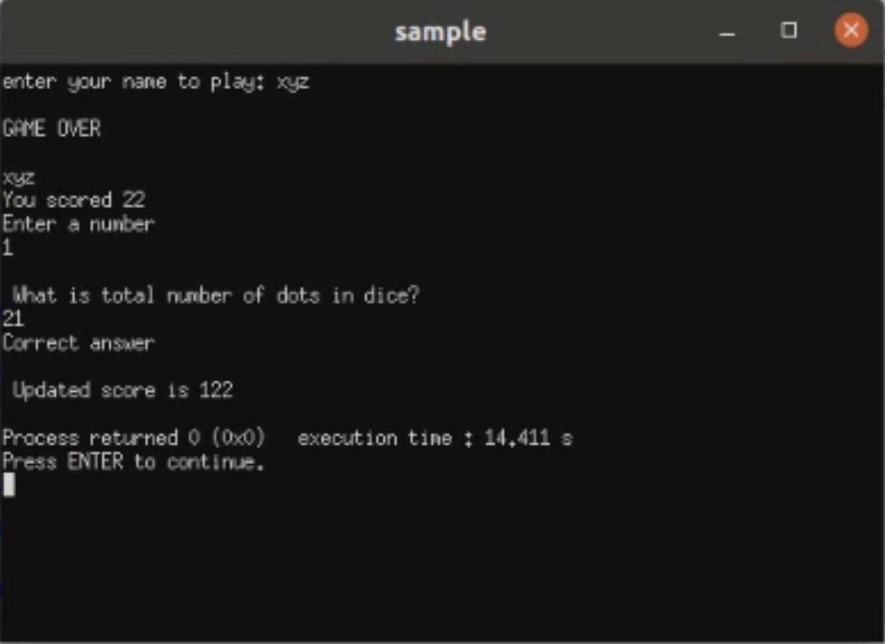

Slide 17
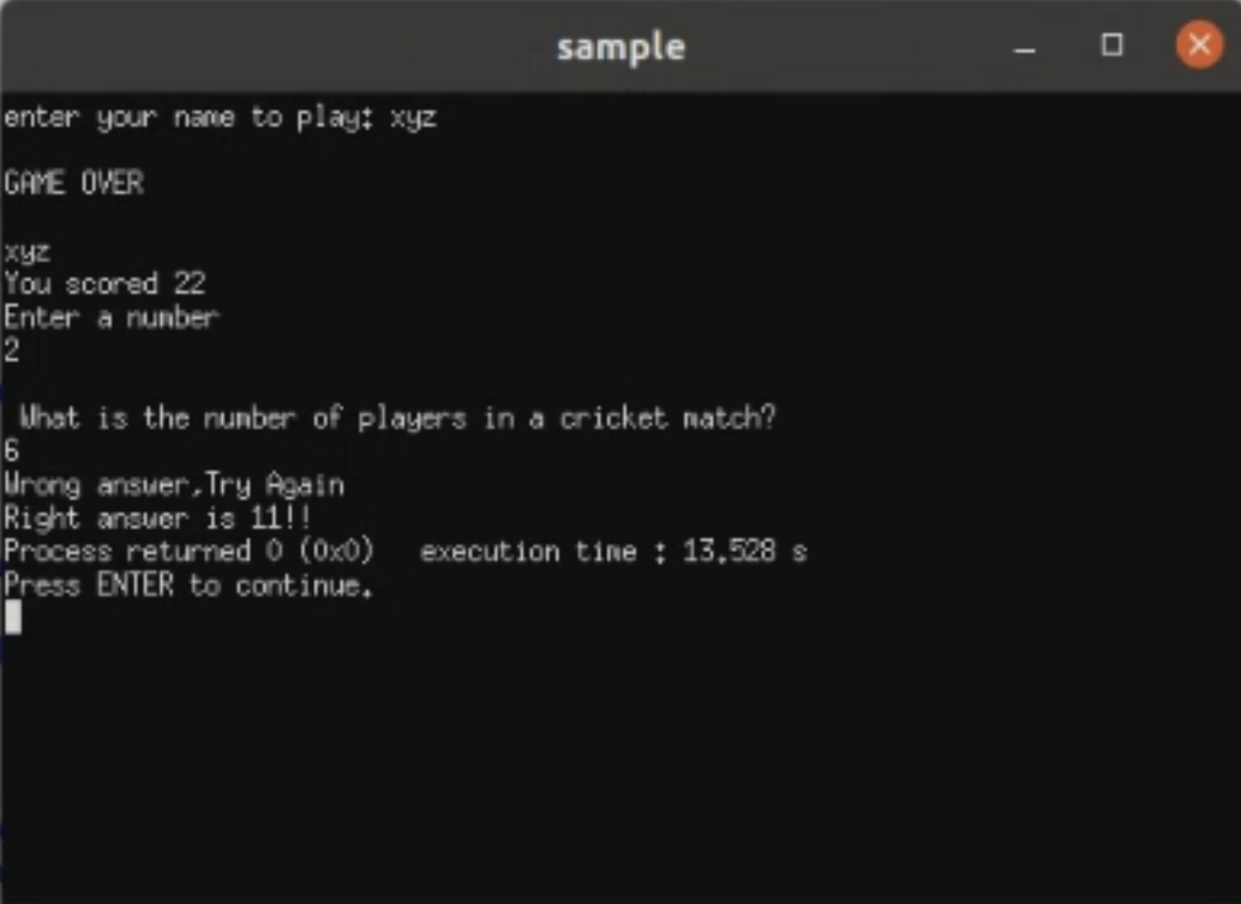

Slide 18
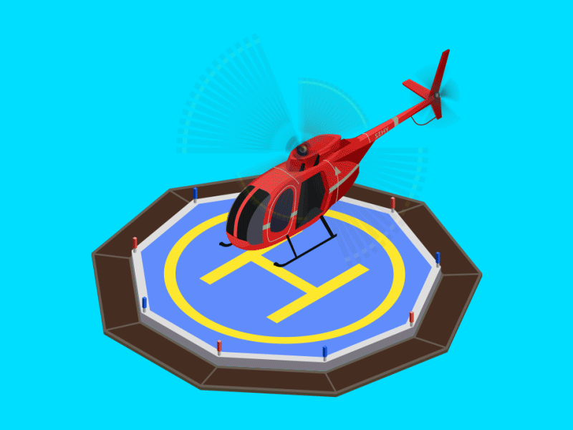
CONCLUSION
We have attempted to design and implement “2D helicopter”.
OpenGL supports enormous flexibility in the design and the use of OpenGL graphics programs.
The presence of many built in classes methods take care of much functionality and reduce the job of coding as well as makes the implementation simpler.
The project was started with the designing phase in which we figured the requirements needed, the layout design, then comes the detail designing of each function after which, was the testing and debugging stage.
We have tried to implement the project making it as user-friendly and error free as possible. We regret any errors that may have inadvertently crept in.

Slide 19
BIBLIOGRAPHY
Computer Graphics – Principals And Practice (Foley, Van Dam, Fenier and Hughes) helped me to understand graphics generation algorithms, user interface and dialogue design
OpenGL Programming Guide (Addison-Wesley Publishing Company) helped me to get through all OpenGL functions and Commands and understandings of all aspects of them.
www.cplusplus.com: - provided references regarding all c++ functions and their uses.
www.stackoverflow.com: - help to get rid of all types of error occurred regarding uses of OpenGL functions.
www.lighthouse3d.com: - OpenGL tutorial for implementing the OpenGL functions in Source code.

Slide 20


